Slide 1
April 26, 2022
Central Plymouth County Water District Commission Meeting

Slide 2
Silver Lake Water Quality Monitoring Overview
Introduction
Project Goals/Objectives
Project Organization
Project Components/Timeline
Silver Lake Sampling Design
Next Steps

Slide 3
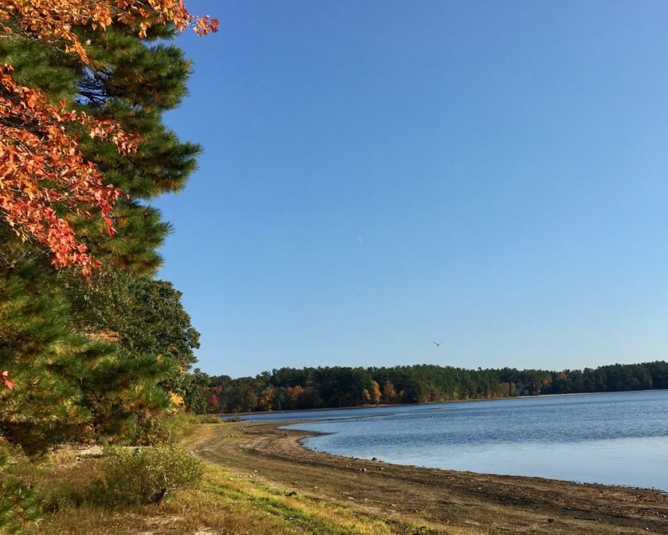
Introduction
Silver Lake is Public Water Supply
System includes diversions from Monponsett and Furnace Ponds
Concerns over water quality/quantity
Silver Lake Impairments: Fish Passage Barrier (new), Flow Regime Modification, and Dissolved Oxygen (new)
East/West Monponsett, Jones River, Eel River, Furnace Pond all impaired
Photo: North South Rivers Watershed Association

Slide 4
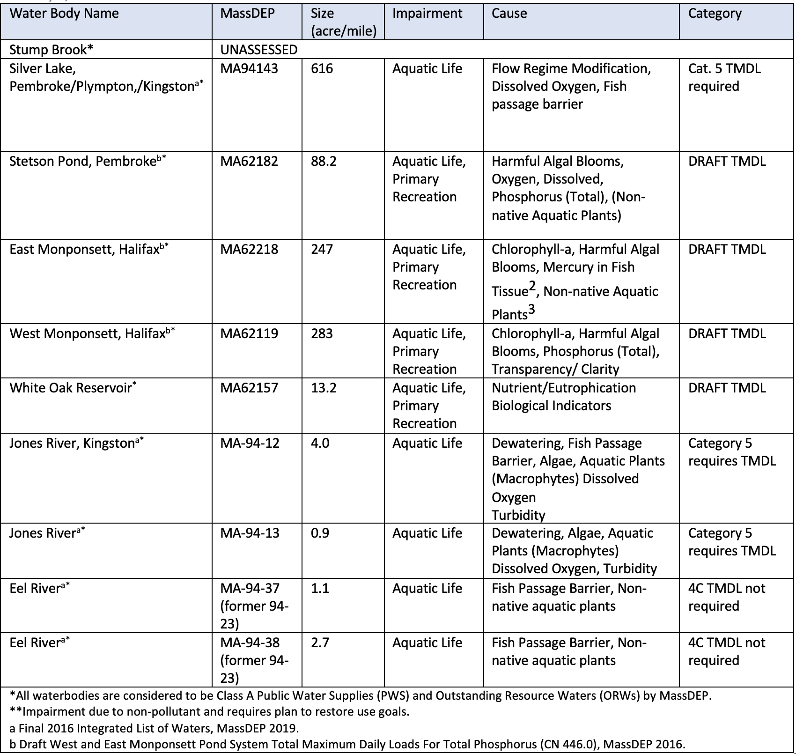

Slide 5
Project Goals/Objectives
Collect water quality data to help inform community management decisions to address water quality and quantity issues in Silver Lake and connected water bodies
Develop a baseline understanding of current water quality and continue to develop solutions-oriented relationships with the City of Brockton’s Water Division and the public
https://www.centralplymouthcountywater.org/water-quality-monitoring-at-silver-lake.html

Slide 6
Project Organization

Slide 7
Project Components/Timeline
Sampling and Analysis Plan (SAP) - Complete
Public Participation Plan (PPP) - Complete
Public Engagement - Aug. 2021, Winter 2023
Final Quality Assurance Project Plan (QAPP) - Complete
Field Data Collection – Aug. 2021 to September 2022
Data Analysis and Technical Memo – Winter 2023
https://www.centralplymouthcountywater.org/water-quality-monitoring-at-silver-lake.html

Slide 8
Silver Lake Project Sampling Design
Silver Lake Mapping (Bathymetry, Aquatic Plants, Macroinvertebrates)
Silver Lake Water Quality (Discrete water quality, data loggers)
Monponsett/Furnace Diversions (Discrete water quality, data loggers)
Upstream/Downstream tributary (Discrete water quality, data loggers, stream discharge)
Groundwater Assessment (Discrete water quality)

Slide 11
Silver Lake Monitoring Parameters
Discrete Water Quality
Data Logger
Total Phosphorus
Total Soluble Phosphorus
Total Suspended Solids
Total Nitrogen (nitrite-N+nitrate-N and Total Kjeldahl N)
Alkalinity
Chlorophyll a
Algal (Phytoplankton) Enumeration and ID
E. coli
Cyanotoxins (Microcystins/Nodularins)
Secchi Disk Transparency
Apparent Color
Turbidity
pH
Water Temperature
Specific Conductance
Dissolved Oxygen.

Slide 12
Next Steps
Review Progress during Commission Meetings- preliminary results this summer
Signatures Final Quality Assurance Project Plan (QAPP) – Post Final Document on website
Field Data Collection – through September 2022
Data Analysis/Technical Memo of findings – Winter 2023
Public Engagement – ongoing, Winter 2023 meeting

Slide 13
Questions
Matt Ladewig,
Project Manager, ESS Group, MLadewig@trccompanies.com
Kimberly Groff, Project Liaison, kimberlygroffma@gmail.com
?

